Slide 1


Web Programming
GitHub

Slide 2

Overview
What is GitHub?
Why GitHub?
Repository
README file
Wiki page
Fork
Branch
Pull request
Issues

Slide 3
What is GitHub
The "Git" in GitHub: Git is an open-source version control system that was started by Linus Trovalds—the same person who created Linux.
The "Hub" in GitHub: where developers store their projects and network with like minded people.
At its heart, GitHub is a collaboration platform
https://www.howtogeek.com/180167/htg-explains-what-is-github-and-what-do-geeks-use-it-for/

Slide 4
Why GitHub
Repository
Forking a Repo
Pull Requests
Social networking/Collaboration
Changelogs
https://www.howtogeek.com/180167/htg-explains-what-is-github-and-what-do-geeks-use-it-for/

Slide 5
Repository
A repository (usually abbreviated to "repo") is a location where all the files for a particular project are stored.
Each project has its own repo, and you can access it with a unique URL.

Slide 6
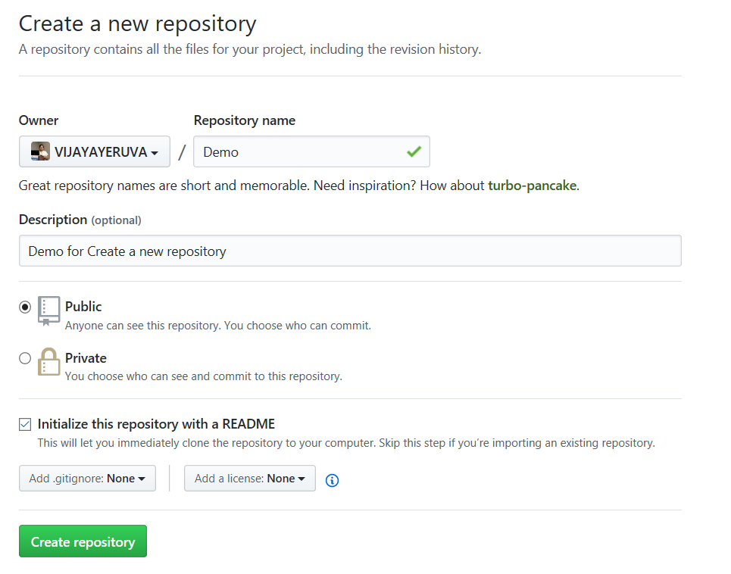
GitHub - Create a new repository

Slide 7
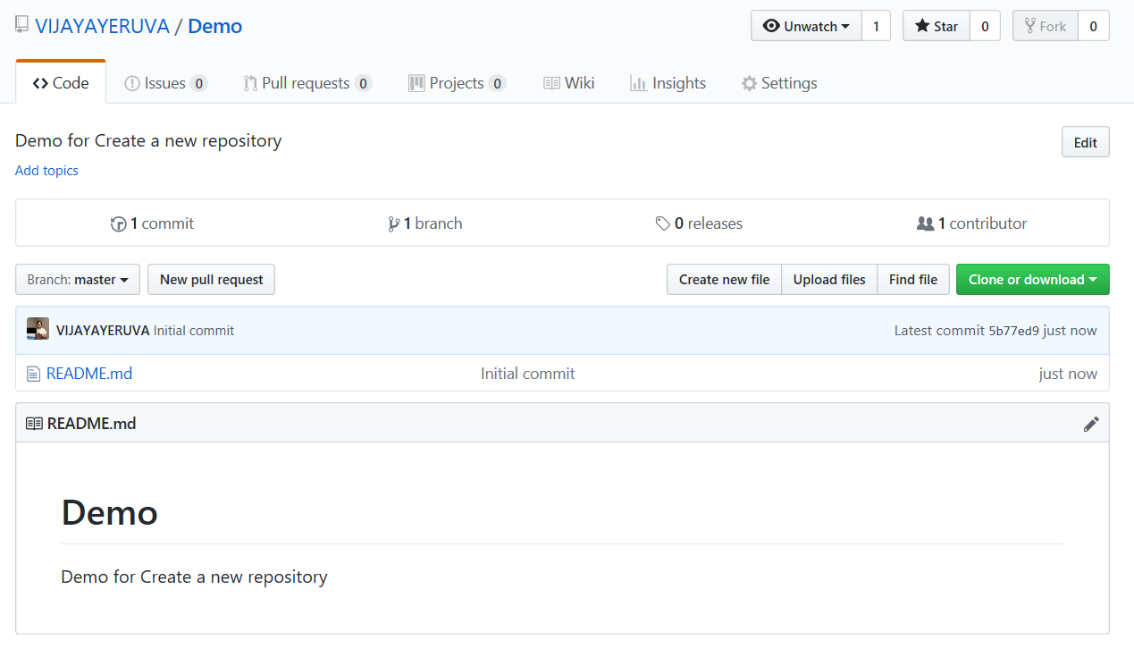
GitHub - Create a new repository

Slide 8
README file
You can add a README file to your repository to tell other people why your project is useful, what they can do with your project, and how they can use it.
README files typically include information on:
What the project does
Why the project is useful
How users can get started with the project
Where users can get help with your project
Who maintains and contributes to the project
https://help.github.com/en/articles/about-readmes

Slide 9
Wiki page
You can use your repository's wiki to share long-form content about your project, such as how to use it, how you designed it, or its core principles.
https://help.github.com/en/articles/about-wikis

Slide 10
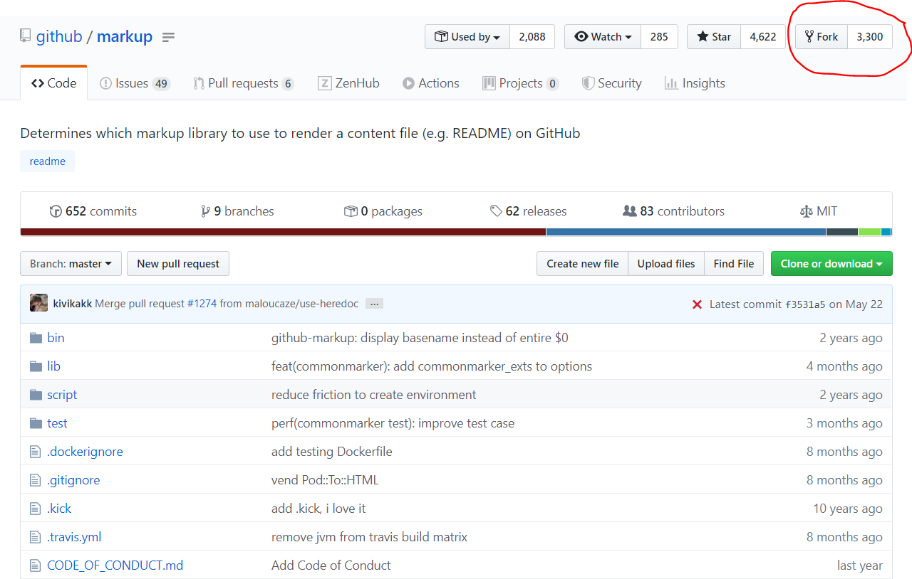
Forking a Repo
"Forking" is when you create a new project based off of another project that already exists.

Slide 11
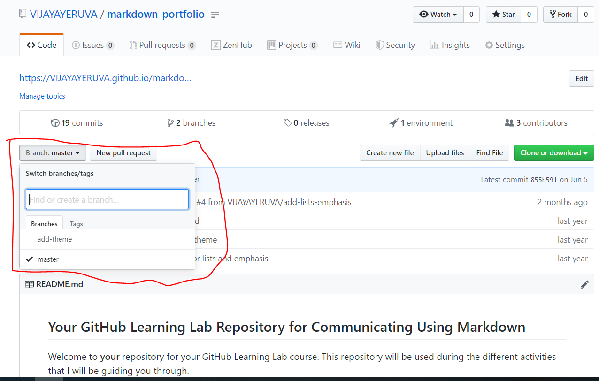
Branch
Branches are an important part of the GitHub flow because they allow us to separate our work from the master branch.
In other words, everyone's work is safe while you contribute.

Slide 12
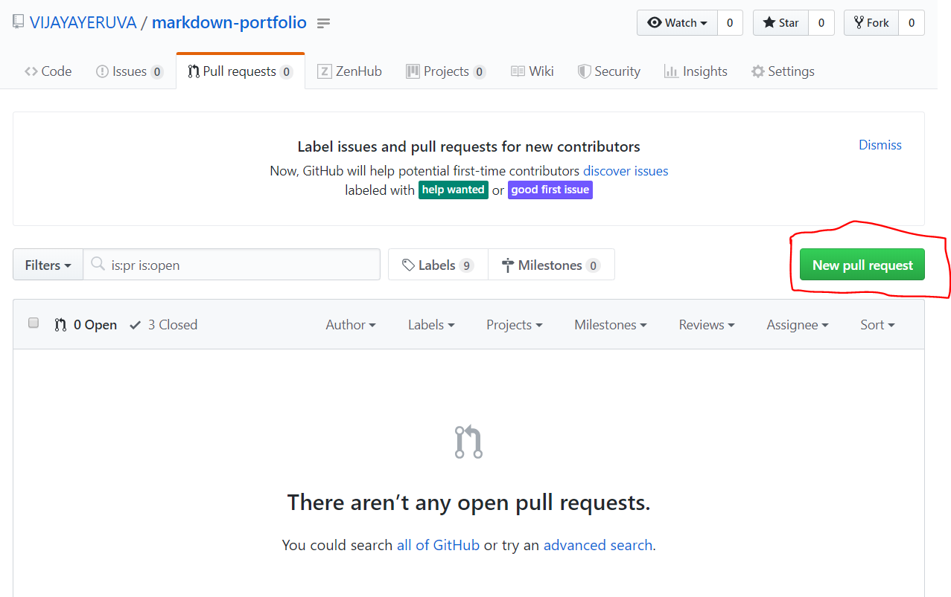
Pull Requests
Pull requests let you tell others about changes you've pushed to a branch in a repository on GitHub.
Once a pull request is opened, you can discuss and review the potential changes with collaborators and add follow-up commits before your changes are merged into the base branch.

Slide 13
Issues
A place where you can have conversations about bugs in your code, code review, and just about anything else.
Issues are used to discuss ideas, enhancements, tasks, and bugs.
They make collaboration easier by:
Providing everyone (even future team members) with the complete story in one place
Allowing you to cross-link to other issues and pull requests
Creating a single, comprehensive record of how and why you made certain decisions
Allowing you to easily pull the right people and teams into a conversation with @-mentions

Slide 14
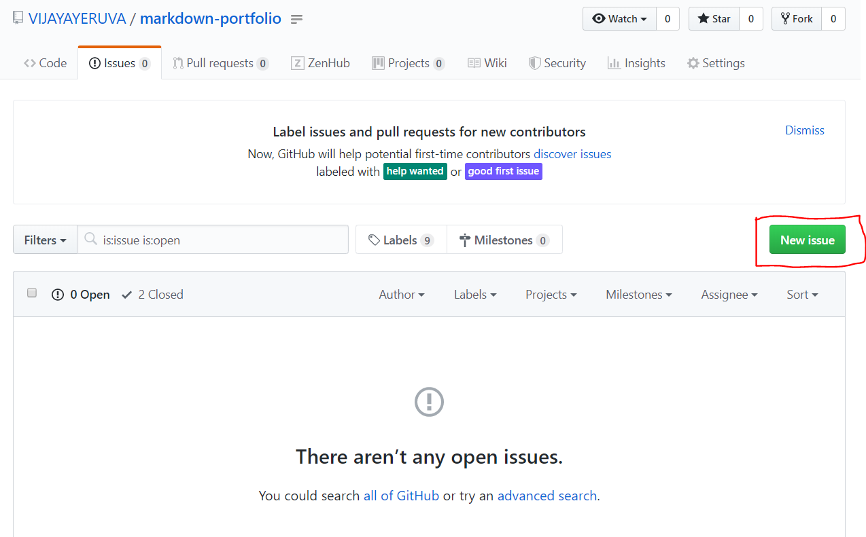
Issues

Slide 15
Repo Structure

Slide 16
Repo Structure

Slide 17
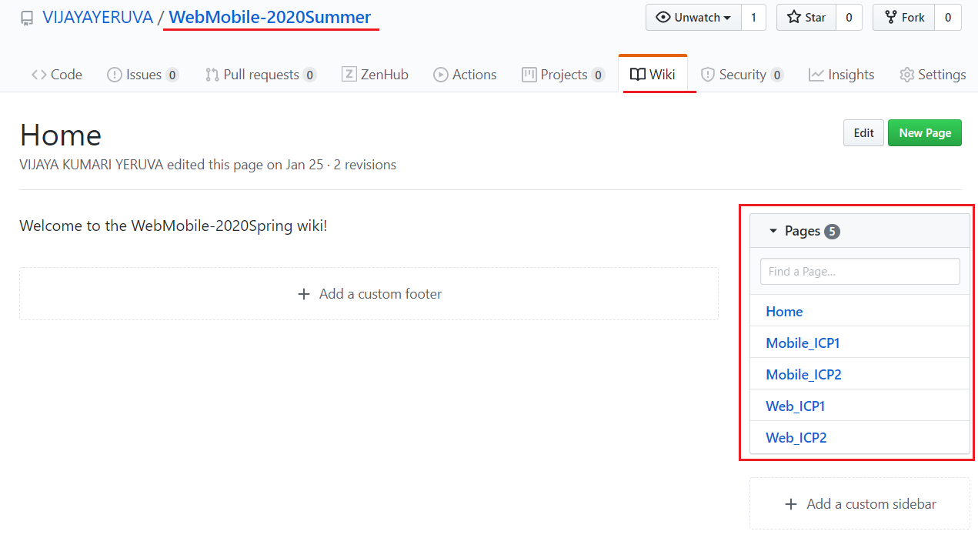
Repo Structure

Slide 18
ICP
Please refer steps in the lesson plan

Slide 19
References
https://help.github.com/en
https://help.github.com/en/articles/about-wikis
https://help.github.com/en/articles/about-readmes
https://www.howtogeek.com/180167/htg-explains-what-is-github-and-what-do-geeks-use-it-for/

